Slide 1
Let The Music Speak Unearthing Australian music trends Brett Scotland Darren McMurtrie Jesse Tan Kailyn Yong Will Bobzin
Notes:
~15 Seconds - Will
-Group Introduction
-Presentation of the topic (VERY brief)
Ideas for new title?!
Title Slide
Include the name of the Project and Group Members

Slide 2





Project analysis slide 2
Introduction
Universal interest
Australian Preferences
What music do Australians like?
286 Million active users
2-4 Million votes yearly
Algorithmic analysis
Ask the right questions
Notes:
Introduction ~1 min - Will
STORYTELLING!
-Explain why music was chosen
-breeze over figures (not important at this stage)
-Essentially sell the project to the audience
Motivation & Summary Slide
Define the core message or hypothesis of your project.
Describe the questions you and your group found interesting, and what motivated you to answer them
Describe whether you were able to answer these questions to your satisfaction, and briefly summarize your findings

Slide 3




Project analysis slide 6
Questions
What makes a song a Triple J Top 100 Winner?
Looking into Valence and Danceability.
When are hits released?
Research the relation between time of release and Hottest 100 performance
What Australian songs do Australians vote?
Analysing the influence of speechiness on a song’s performance
Do Australians like long songs?
Determine if song length affects ranking performance.
Notes:
Approx 30 seconds - Kailyn
Questions & Data
Elaborate on the questions you asked, describing what kinds of data you needed to answer them, where and how you found the data you used to answer these questions

Slide 4
Project analysis slide 8
Data Sources
STRENGHTS
CHALLENGES
ACCURATE REFLECTION
BIASED
Reflects Australian tastes in Music
Manageable size for a robust sample (2500 lines/25 years)
Artist and song titles recorded using own notation.
Heavily biased towards Australian and Alternative artists
TRIPLE J
EXTENSIVE DATA
UNIQUE FORMAT
Data for over 170K tracks.
Technical track analysis – extensive and consistent
Artist and song titles recorded using own notation
Some songs are not present.
SPOTIFY
Notes:
Data Sources ~30 seconds - Kaylin
-Why did we choose this data sources?
-Focus on opportunities and challenges
-don’t’ read from the slide!

Slide 5
Project analysis slide 4
Data Framework
What makes a song a Triple J Top 100 Winner?
Plenty of information, so focus on hypothesis to avoid branching.
Triple J Hottest 100 data 1993 - 2017
Occasional unreliable data eg. Tracks released as single before album.
When are hits released?
Merged Data
Hypothesis Testing
What Australian songs do Aussies vote?
What sets Australian songs apart from the rest.
Spotify database – track level quantitative data 1921 - 2020.
Data pivoting by artist and song.
Tools, Resources and challenges.
How did we apply the data?
Does song length make a difference?
Do Australians like long songs?
Notes:
Now I will introduce what and how we merged our data.
Slide 4B – Data Merging – 4 Hypothesis – 30 seconds to 1 minute - Jesse
-Data has already been presented, so focus on execution (what we did and how)
-don’t just focus on what we did and what worked, tell what we tried and didn’t work (Jellyfish, FuzzyBuzzy, etc) (issues matching, missing songs)
Data Cleanup & Exploration
Describe the data exploration and cleanup process (accompanied by your Jupyter Notebook)
Discuss insights you had while exploring the data that you didn't anticipate
Discuss any problems that arose after exploring the data, and how you resolved them
Present and discuss interesting figures developed during exploration, ideally with the help of Jupyter Notebook

Slide 6
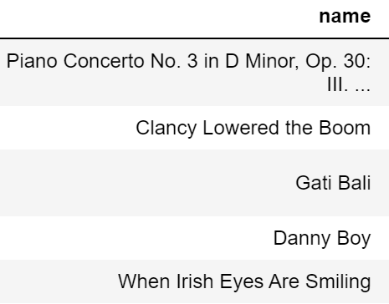
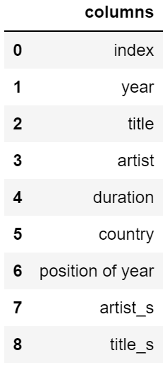
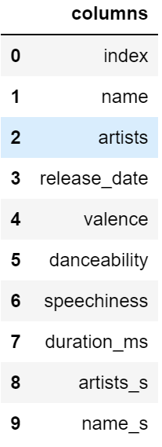
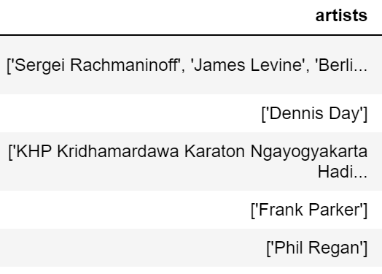
Project analysis slide 4
Data Framework
Triple J dataset
Spotify dataset
`
Notes:
To merge the dataset, we need to match the song’s name and artist. But in these data sets, the name and artist are in a different format. And there are some special characters in those datasets.
Slide 4B – Data Merging – 4 Hypothesis
-Data has been presented, so focus on execution (how did we achieve this?)
Data Analysis
Discuss the steps you took to analyze the data and answer each question you asked in your proposal
Present and discuss interesting figures developed during analysis (accompanied by your Jupyter Notebook)

Slide 7
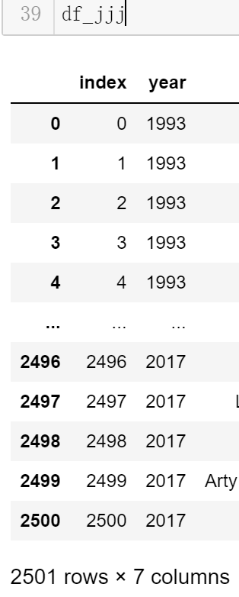
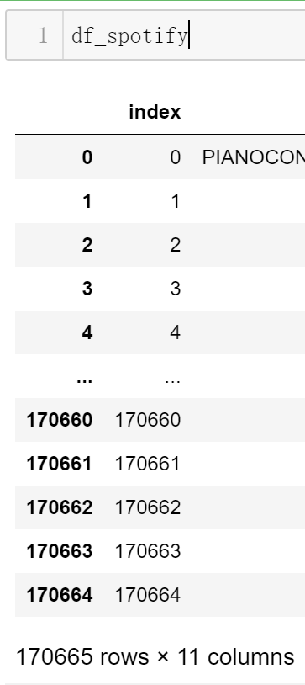
Data Framework
Challenge
How to match columns when special characters and symbols appear?
How to make sure the matching can be done quickly in such a big data set?
2,501 x 170,665 = 426,833,165 !
Notes:
That gives us a challenge: How can we match those columns.

Slide 8
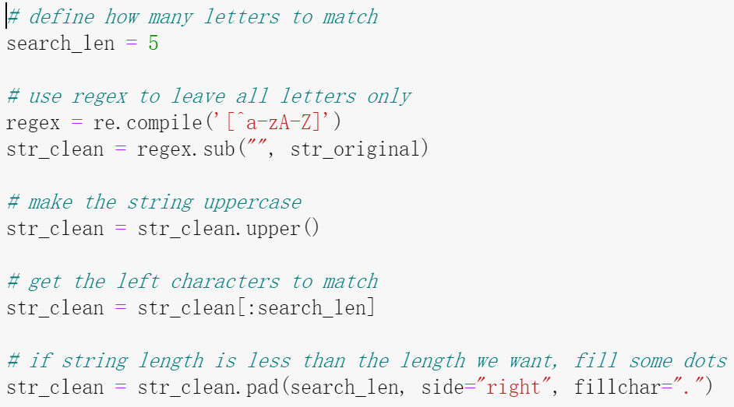
Project analysis slide 4
Data Framework
Some other libraries we tried:
FuzzyWuzzy
Jellyfish
Problem: 2500 rows in Triple J dataset and 170k rows in Spotify dataset, using these libraries will do the full table scan which will be very slow.
Triple J dataset
Spotify dataset
`
Notes:
We search for some solutions such as FuzzyWuzzy and Jellyfish, but they have the same problem is speed. We ran the codes using FuzzyWuzzy for more than half an hour and there was still no result. So we later tried another way to it.
We first use regular expression to delete all special characters and symbols, just leave letters only. Next we turn the string to uppercase. And then we shorten the strings to 5 characters and do the merge, join by the result string.
Slide 4B – Data Merging – 4 Hypothesis
-Data has been presented, so focus on execution (how did we achieve this?)
Data Analysis
Discuss the steps you took to analyze the data and answer each question you asked in your proposal
Present and discuss interesting figures developed during analysis (accompanied by your Jupyter Notebook)

Slide 9
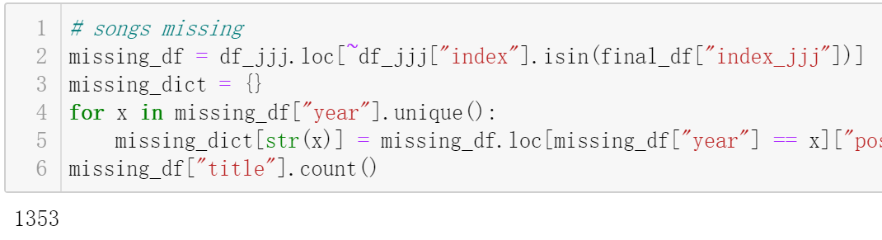
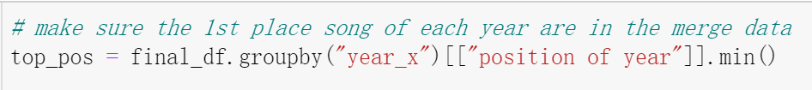
Project analysis slide 4
Data Framework
Problem found after merge: about half songs can not find a match in spotify dataset
Good point: all the 1st place songs can find a match in spotify dataset
Notes:
After we got the merge dataset, we have about half of the triple J songs left and the 1st place song of each year is in the merge dataset.
Slide 4B – Data Merging – 4 Hypothesis
-Data has been presented, so focus on execution (how did we achieve this?)
Data Analysis
Discuss the steps you took to analyze the data and answer each question you asked in your proposal
Present and discuss interesting figures developed during analysis (accompanied by your Jupyter Notebook)

Slide 10
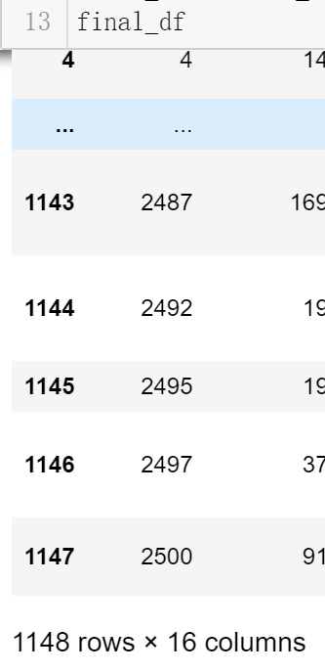
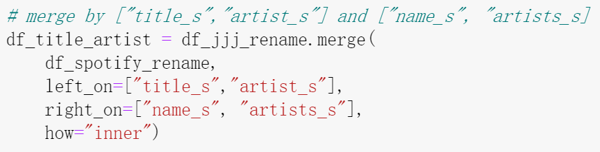
The merged dataset:
1. 1148 rows out of the 2501 rows, nearly half of the original dataset.
2. Includes every years first place song.
3. Got all the columns we need for our hypothesis
Good enough for us to do the analyse
Notes:
So we thought that’s good enough for us to finish our hypothesis test. Now I will pass it to Darren and Brett to introduce our hypothesis test.

Slide 11
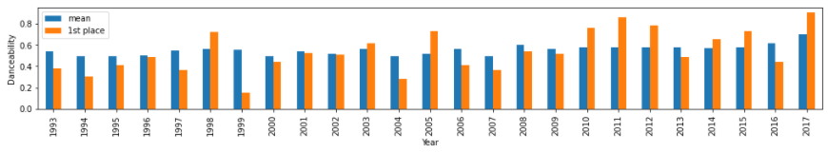
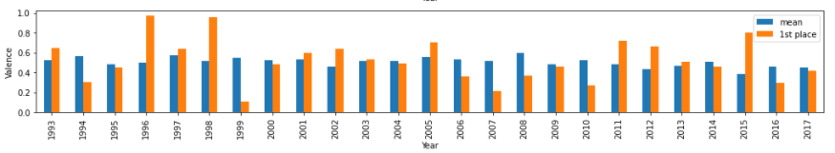
Project analysis slide 10
What makes a Triple J Winner?
Hypothesis
Testing
Conclusion
Triple J Hottest 100 winners are expected to show high positive energy (expressed as high valence) and low danceability (representing more elaborate songs) compared to other tracks.
Compared danceability and valence for each years winner against the runner ups. A single sample t-test will show whether danceability or valence is correlated with a song being a winner.
Neither valence or danceability have shown to be related to a song being a winner within the analysed timeframe.
Ttest_1sampResult(statistic=-0.3738255644108187, pvalue=0.7118162360398623)
Ttest_1sampResult(statistic=0.321418279106471, pvalue=0.7506759443702175)
Notes:
1 minute - Darren
Data Analysis
Discuss the steps you took to analyze the data and answer each question you asked in your proposal
Present and discuss interesting figures developed during analysis (accompanied by your Jupyter Notebook)

Slide 12
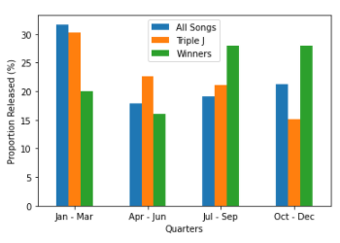
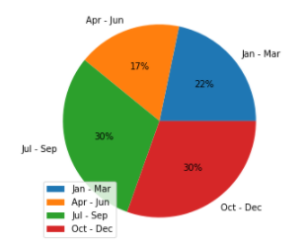
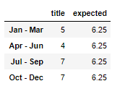
Project analysis slide 10
When are hits released?
% of Population vs Triple J List vs Triple J Winners by Release Quarter
Hypothesis
We believe ideal time to release a Hottest 100 winner is between Quarter 2 of a given year. Earlier and track is not “fresh”, later it’s still not as well known
Testing
Binning release dates by month, and using a chi analysis to determine if winners are released following normal distribution.
Chi test – Winners by Release Quarter
Distribution of Winners by Release Quarter
Conclusion
Chi test shows that a disproportionate number of winners for the analysed period were released in Q3 and Q4. This is particularly noteworthy, as Q1 shows the highest amount of released tracks. It is worth mentioning that the sample is 23 winning songs, so it’s relatively small.
WPower_divergenceResult(statistic=1.2400000000000002, pvalue=0.7434275021945493)
e
Notes:
1 minute - Brett
Data Analysis
Discuss the steps you took to analyze the data and answer each question you asked in your proposal
Present and discuss interesting figures developed during analysis (accompanied by your Jupyter Notebook)

Slide 13
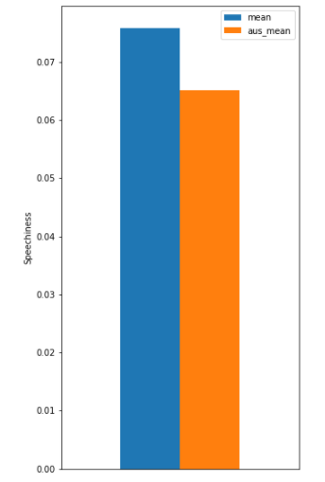
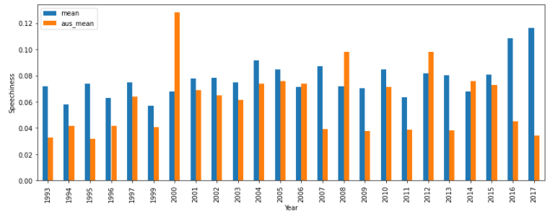
Project analysis slide 10
What Australian songs do Aussies vote?
Hypothesis
Testing
Conclusion
Australians prefer songs with higher speechiness, as they gravitate towards familiar accents.
Compare, for each year, speechiness for Australian artists (as defined by Triple J) vs the all other artists.
Data demonstrates that Australian Triple J voters prefer less speechiness in their Australian songs. The results are significant, but some exceptions were observed.
Ttest_1sampResult(statistic=5.287851252325091, pvalue=1.4810478542864767e-07)
Notes:
1 minute - Darren
Data Analysis
Discuss the steps you took to analyze the data and answer each question you asked in your proposal
Present and discuss interesting figures developed during analysis (accompanied by your Jupyter Notebook)

Slide 14
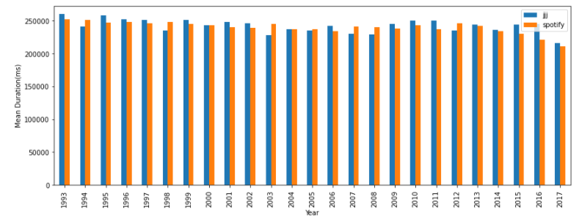
Project analysis slide 10
Do Australians prefer long songs?
Hypothesis
Testing
Conclusion
We expect shorter songs, friendlier to heavy airplay, to perform better than relatively longer songs.
Compared each years top 100 duration mean vs all songs released duration mean.
The analysis shows there is no significant difference in length (in ms) between winning songs and the mean of the population. Only 2016 showed a significant result. Given the number of years analysed and the pvalue of 0.0879 it is reasonable to assume it was by chance.
Notes:
1 minute - Brett
Data Analysis
Discuss the steps you took to analyze the data and answer each question you asked in your proposal
Present and discuss interesting figures developed during analysis (accompanied by your Jupyter Notebook)

Slide 15


Project analysis slide 3
Closing remarks
SONG RELEASE - GRANULARITY
DATA MASHING ANALYSIS
LOUDNESS AS A PARAMETER
SAMPLE SIZE CHALLENGES
Time permitting, would have liked to dig into song release dates at a month level, instead of quarter.
Matching data between sources was the greatest technical challenge. Data wangling and some manual input were required
We explored using “Liveness” as a factor to determine if a song would be voted, but it didn’t reflect an artistic quality but rather a technical quality of the track.
Hottest 100 dataset, at 100 songs per year, still represents a small sample compared to the population. With 25 “winners” trends are not always evident.
Notes:
30 seconds - Will
Post Mortem
Discuss any difficulties that arose, and how you dealt with them
Discuss any additional questions that came up, but which you didn't have time to answer: What would you research next, if you had two more weeks?

Slide 16
Project analysis slide 2
Sources & Tools
Data:
Explanation of each category used to describe a track, Spotify API documentation, retrieved 12-JAN-21 - https://developer.spotify.com/documentation/web-api/reference-beta/#category-tracks
Spotify API track database (released 1921 – 2020) (CSV) , consolidated by Kaggle user Yamaerenay, retrieved 12-JAN-21: https://www.kaggle.com/yamaerenay/spotify-dataset-19212020-160k-tracks?select=data.csv
Triple J Top 100 final ranking Database (1993 - 2017 ) (CSV) created by github user majames, retrieved 14-JAN-21- https://github.com/majames/hottest100/
Software:
-Jupyter Notebooks
-Python 3.0 – Anaconda
-Pandas
Libraries & Platforms:
-Matplotlib
-SciPyStats
-NumPy
-FuzzyWuzzy
-JellyFish
-Microsoft Office (Excel, Word, Powerpoint)
-GitHub

Slide 17
Thank You
Notes:
Questions
Open-floor Q&A with the audience

